Slide 1

UNESCO Recommendation on Open Science
Dr Ana Persic, Programme Specialist, Science Policy and Partnerships, UNESCO
OASPA Webinar: Policy into Action: the UNESCO Recommendation on Open Science under the spotlight – actions for publishing
15 March 2022

Slide 2
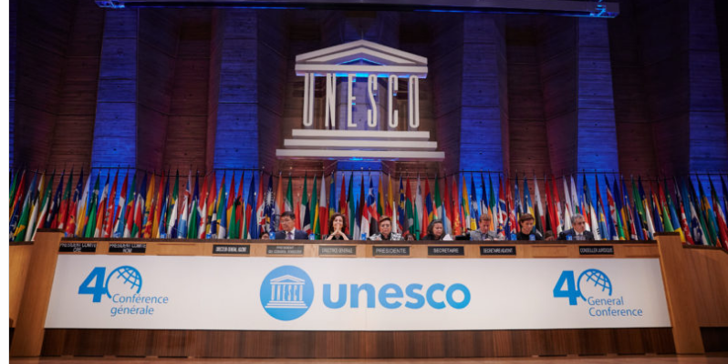
UNESCO Recommendation on Open Science
Need for an international policy and action framework
Need for a common definition of open science, shared set of values and principles
In 2019, at the UNESCO 40th General Conference, 193 Members States tasked UNESCO with the development of an international standard-setting instrument on Open Science in the form of a UNESCO Recommendation on Open Science.
UNESCO Recommendations
Legal instruments in which “the General Conference formulates principles and norms for the international regulation of any particular question and invites Member States to take whatever legislative or other steps may be required in conformity with the constitutional practice of each State and the nature of the question under consideration to apply the principles and norms aforesaid within their respective territories”.

Slide 3
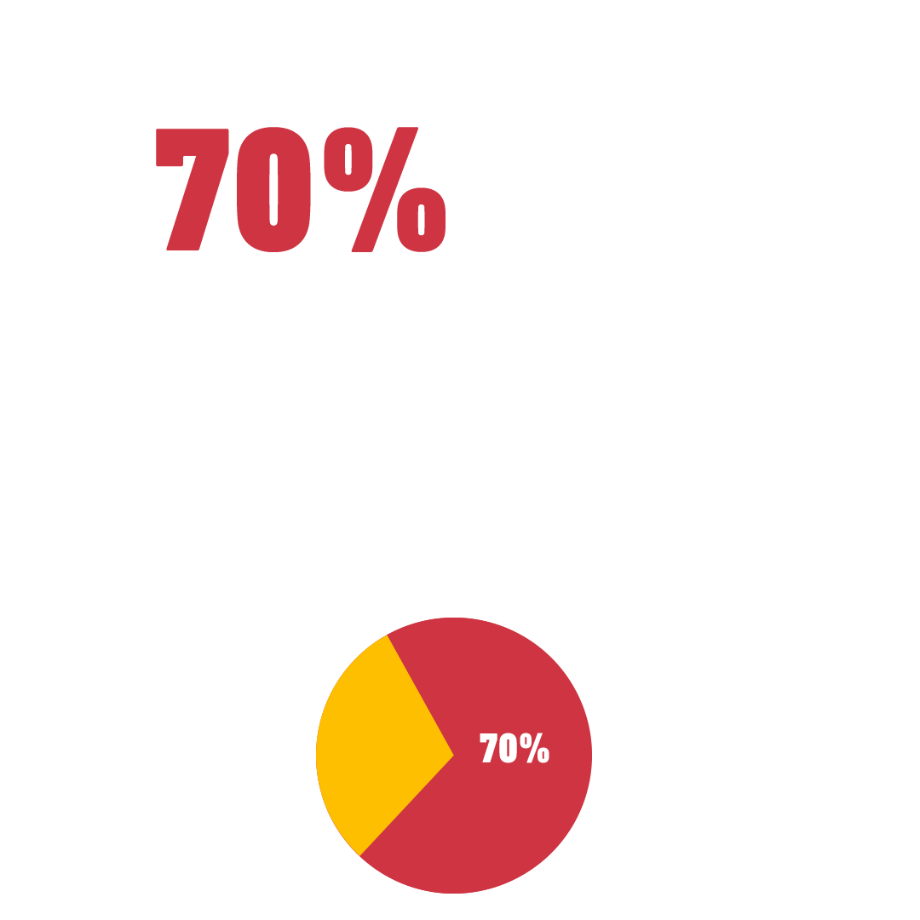

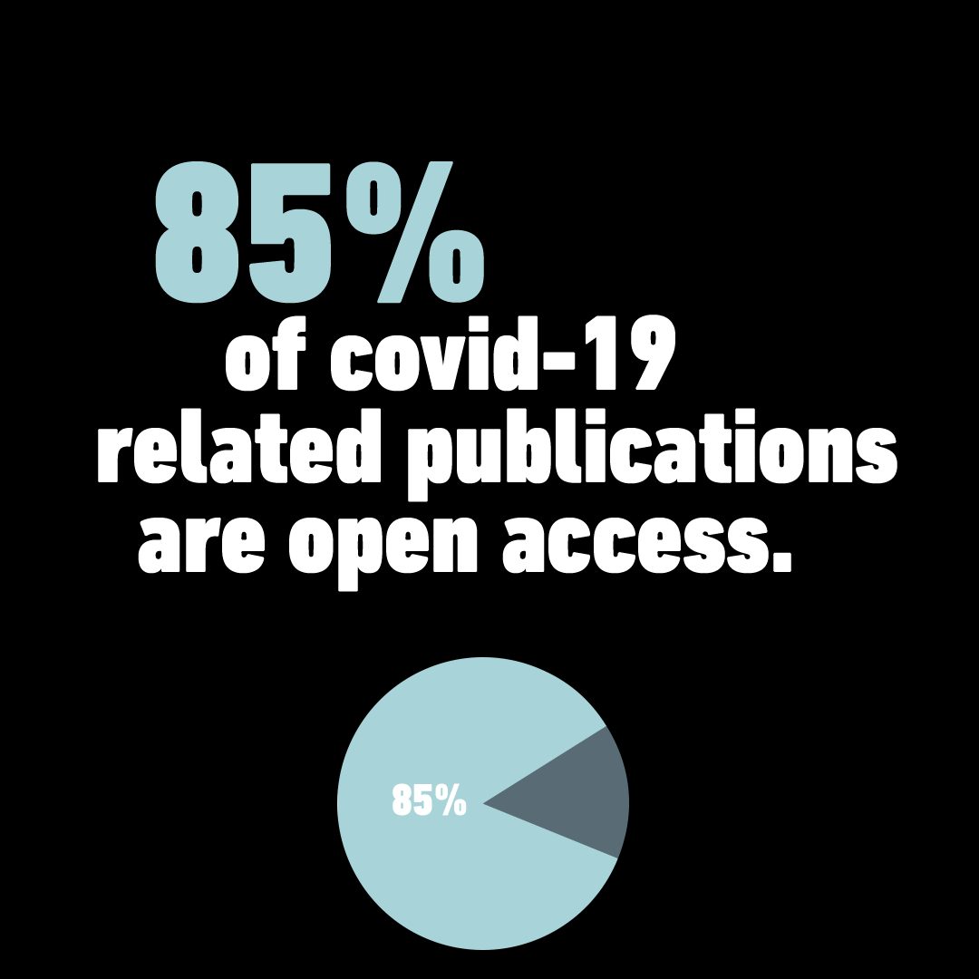
Lessons learned from COVID 19
Importance of timely and free access to scientific data, publications, information
Importance of scientific collaborations and sharing of information at all levels
Importance of science-policy-society dialogue
Importance of open science
Notes:
The UNESCO Recommendation on Open Science, was developed during a pandemic that was a reminder of the fact that challenges of our times do not know borders. therefore, to face them we need inclusive solutions created by participation of all.
In fight against the pandemic international scientific community proved that a more transparent, collaborative and inclusive science is more efficient. While still 70% of the scientific publications are locked behind paywalls, scientist have published more than 85% of their publications related to covid19 with open access for everyone.
The pandemic showed us:
Importance of timely and free access to scientific data, publications, information
Importance of scientific collaborations and sharing of information at all levels
Importance of science-policy-society dialogue

Slide 4
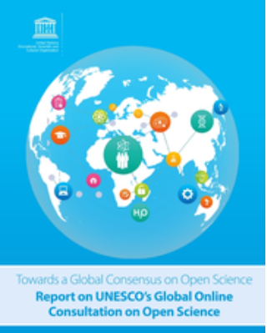

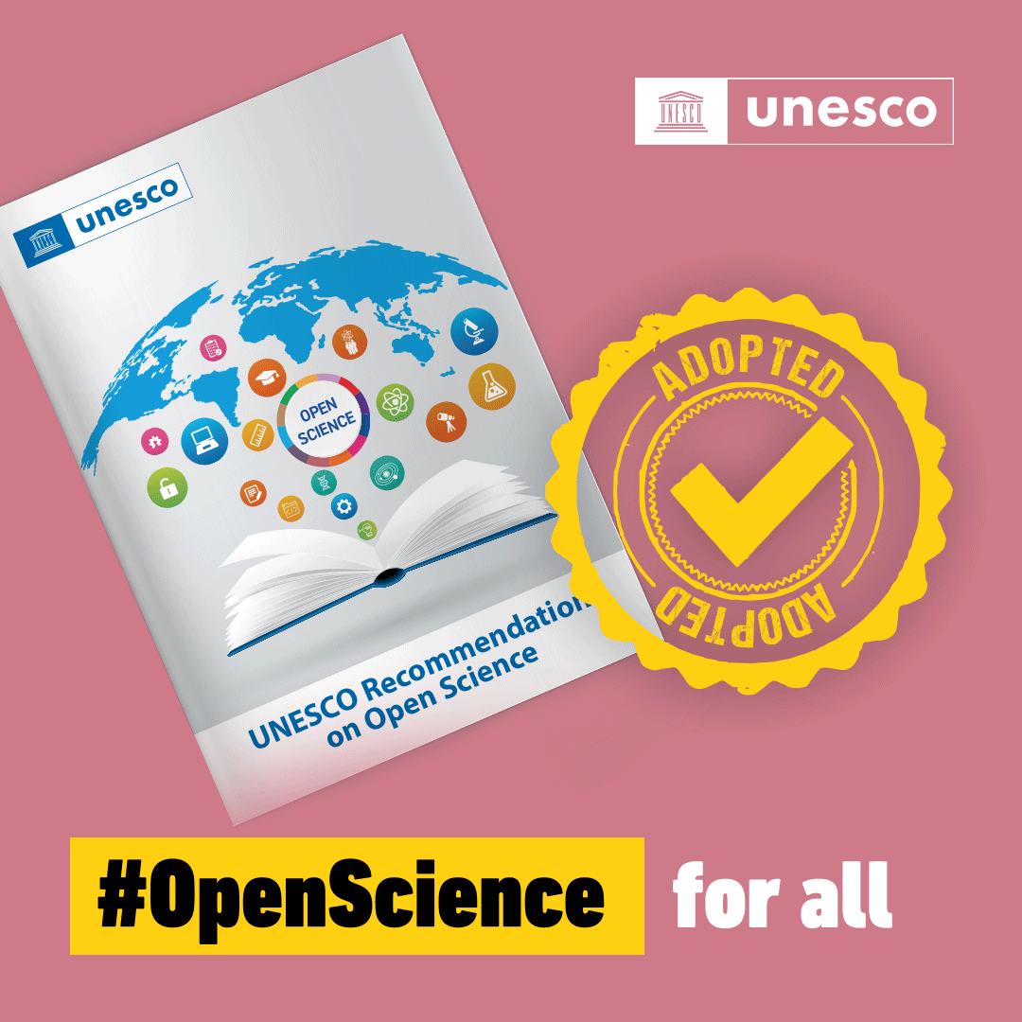
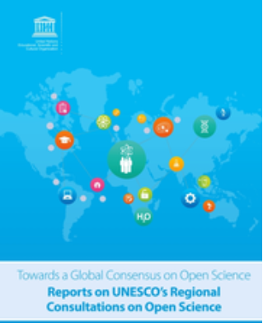
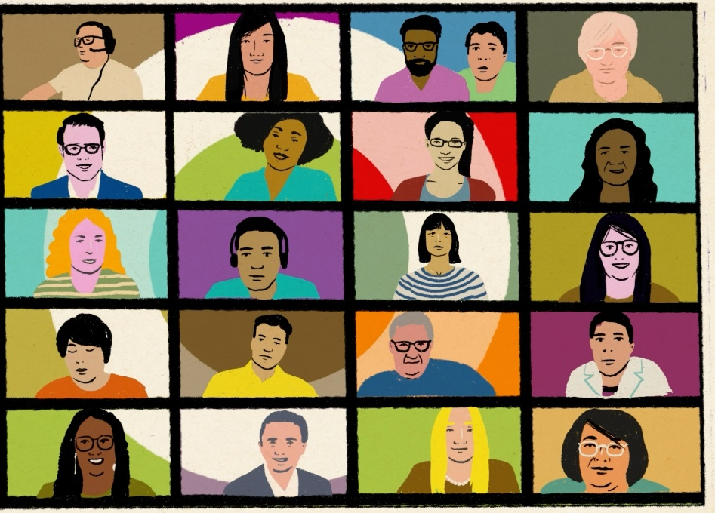
Towards the UNESCO Recommendation on Open Science
UNESCO led a two-year inclusive, transparent and consultative process:
  A global online consultation (online survey) on open science
  Regional multistakeholder consultations for the 6 UNESCO electoral groups
  Thematic consultations and inputs from partners and stakeholder groups
  The draft text of the Recommendation was negotiated by the intergovernmental
  special committee meeting of experts, May 2021.
  193 countries at the 41st UNESCO General Conference in November 2021 adopted the Recommendation.
Notes:
Note: all inputs and the reports of the global, regional and thematic consultations are available on the webpage of the open science webpage.

Slide 5
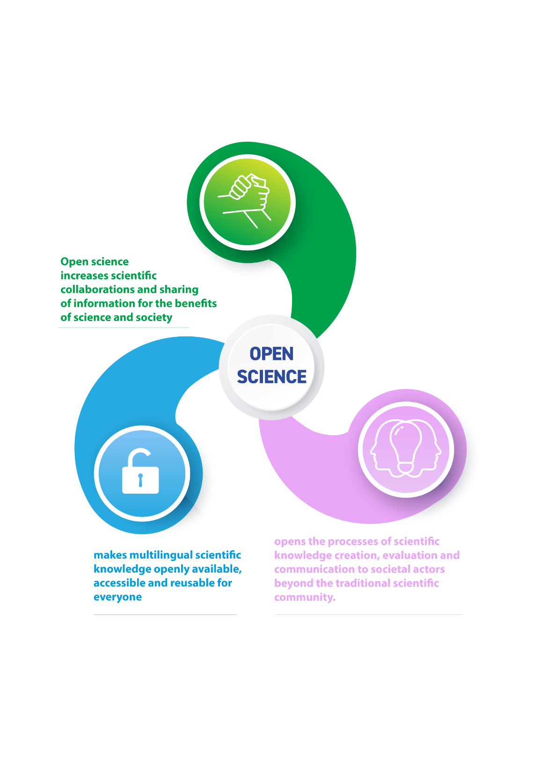
A Common Definition of Open Science

Slide 6
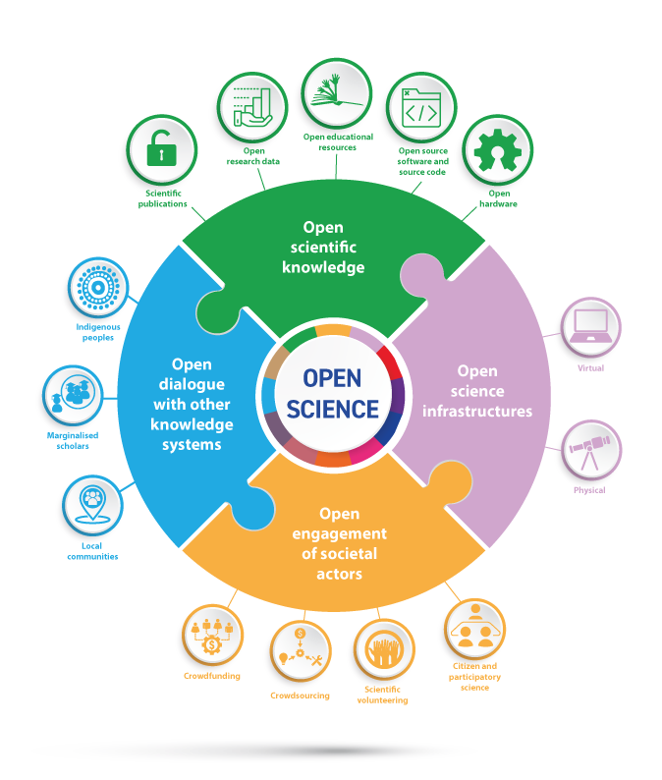
Key Pillars of Open Science
Notes:
The recommendation provides and inclusive definition of open science as a construct that combines various movements and practices aiming to make multilingual scientific knowledge openly available, accessible and reusable for everyone, to increase scientific collaborations and sharing of information for the benefits of science and society, and to open the processes of scientific knowledge creation, evaluation and communication to societal actors beyond the traditional scientific community…

Slide 7

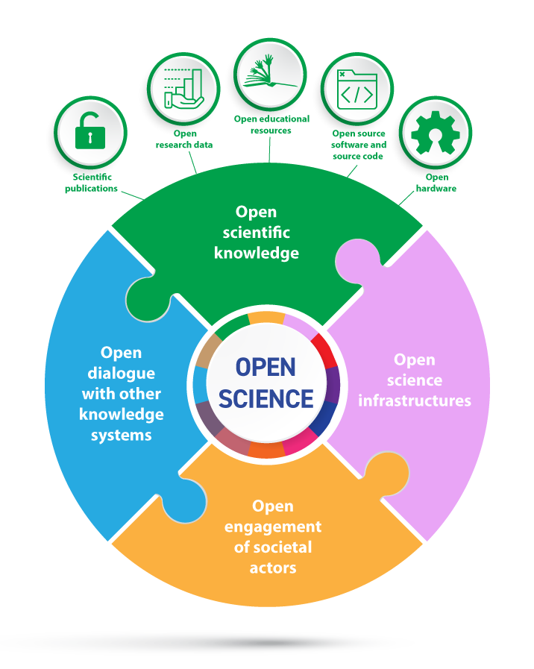
Open Access Scholarly Publishing
Scientific publications include, among others, peer-reviewed journal articles and books, research reports and conference papers.
Platforms/repositories Scientific publications may be disseminated by publishers on open access online publishing platforms and/or deposited and made immediately accessible in open online repositories upon publication, that are supported and maintained by an academic institution, scholarly society, government agency or other well established not-for-profit organization devoted to the common good that enables open access, unrestricted distribution, interoperability and long-term digital preservation and archiving.
Scientific outputs related to publications (e.g. original scientific research results, research data, software, source code, source materials, workflows and protocols, digital representations of pictorial and graphical materials and scholarly multimedia material) that are openly licensed or dedicated to the public domain should be deposited in a suitable open repository, following appropriate technical standards that allow them to be properly linked to publications.

Slide 8
Open Access Scholarly Publishing
Open access
A paywalled method of publication, where immediate access to scientific publications is only granted in exchange for payment, is not aligned with the present Recommendation, which covers open access to scientific publications, research data, metadata, open educational resources, software, and source code and hardware that are available in the public domain or under copyright and licensed under an open license that allows access, re-use, repurpose, adaptation and distribution under specific conditions, provided to all actors immediately or as quickly as possible regardless of location, nationality, race, age, gender, income, socio-economic circumstances, career stage, discipline, language, religion, disability, ethnicity or migratory status or any other grounds, and free of charge.
Any transfer or licensing of copyrights to third parties should not restrict the public’s right to immediate open access to a scientific publication.

Slide 9
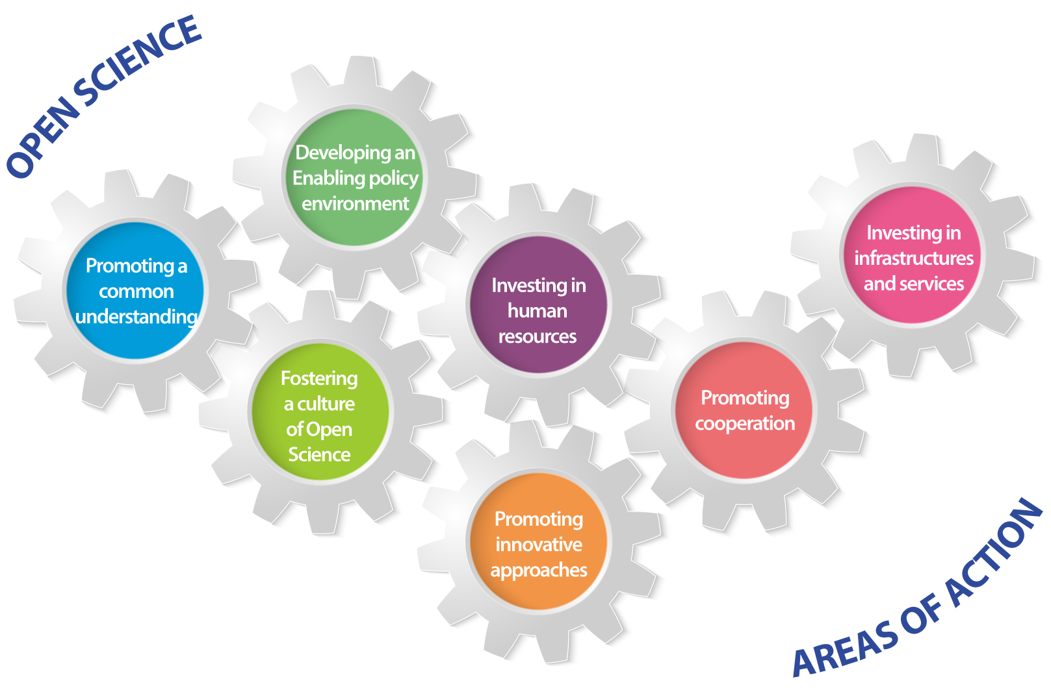
Areas of Action
Notes:
And recommends areas of action for a fair transition to open science

Slide 10
Open Access Scholarly Publishing in Actions
Encouraging bibliodiversity
Encouraging multilingualism
Adopting policies that require and reward open access to scientific knowledge
Ensuring diversity, open, transparent and equitable access and supporting non-commercial publishing models and collaborative publishing models with no APCs/BPCs
Encouraging community-driven collaboration and other innovative models, for example preprints
Promoting open peer review
Sharing of negative scientific results
Incorporating citizen science and other forms of participatory science
Preventing and mitigating predatory behaviors, data migration, exploitation and privatization of research data, increased costs for scientists and high article processing charges

Slide 11
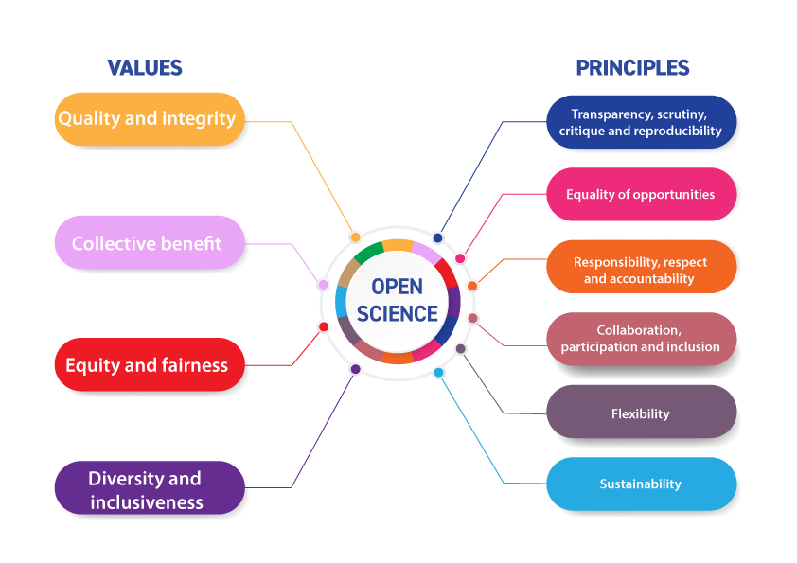
Values and Principles
Notes:
It provides a set of shared values and guiding principles for open sience

Slide 12


Next steps towards implementation of the Recommendation
28 March 2022, Online meeting on the Implementation of the UNESCO Recommendation on Open Science, with Partners and Member States
https://en.unesco.org/events
28 March 2022, launch of a global call for best practices of open science (online survey) https://on.unesco.org/openscience
Join the open science movement
Notes:
UNESCO assist Member

