Slide 1
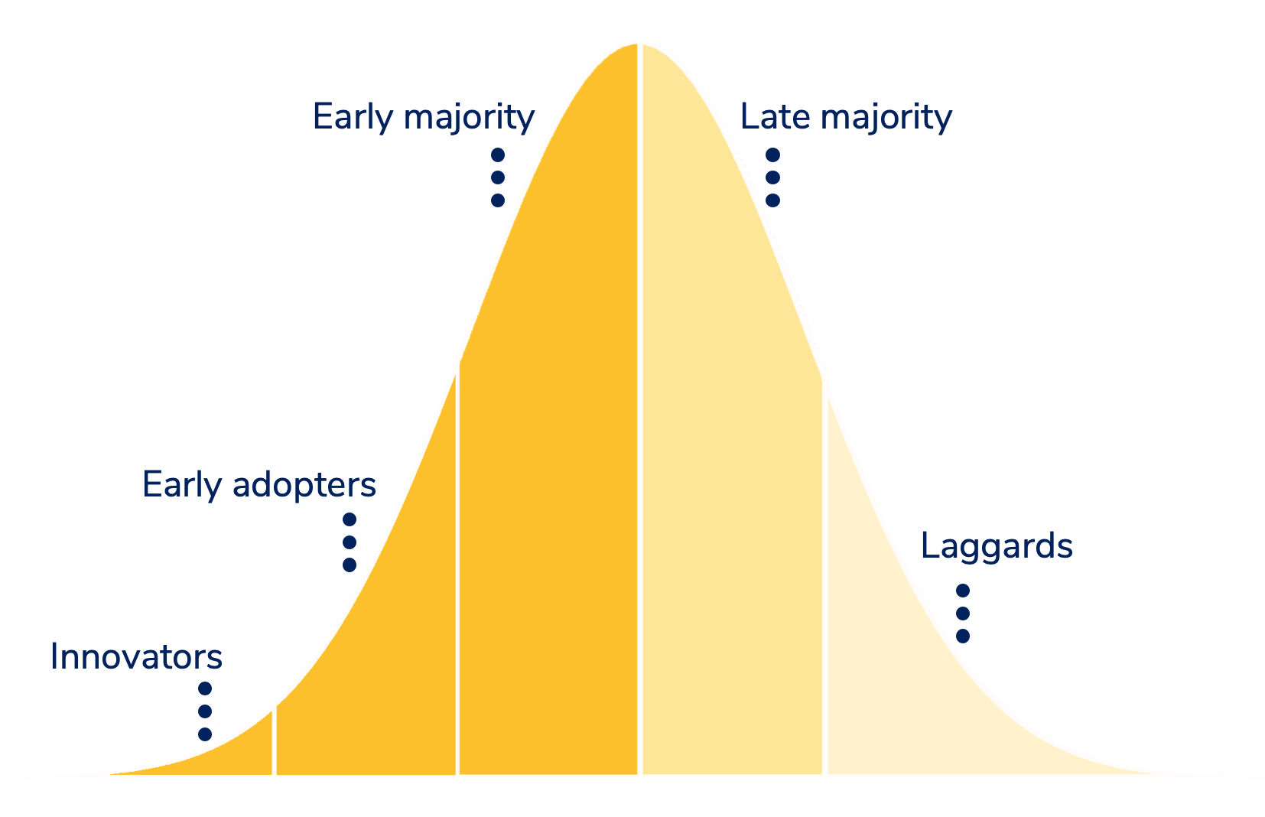
(Rogers, 1962)

Slide 2
“We should all adopt OS practices”
Policy makers
Researchers

Slide 3
“I’m already practising OS”
“We should all adopt OS practices”
Ignorant
Policy makers
Policy makers
Expert
Researchers
Researchers

Slide 4
“Yes, but how?”
“We should all adopt OS practices”
Ignorant
Policy makers
“Yes, but why?”
Policy makers
Interested
Researchers
Researchers
“What?”

Slide 5
“We should all adopt OS practices”
Ignorant
Policy makers
Policy makers
Researchers
Researchers
Ignorant
……..

Slide 6
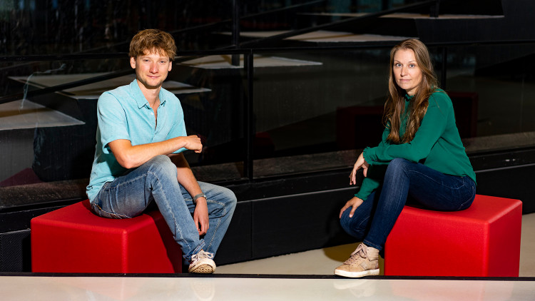

Goals Open Science/Scholarship Community
Make OS knowledge more visible and accessible
  Promote peer-to-peer knowledge exchange
Inspire and enable researchers to take the next small step
Identify obstacles and need for support to inform policy makers

Slide 7


Expert
Interested

Slide 8
How to pre-register?
I can help you!

Slide 9
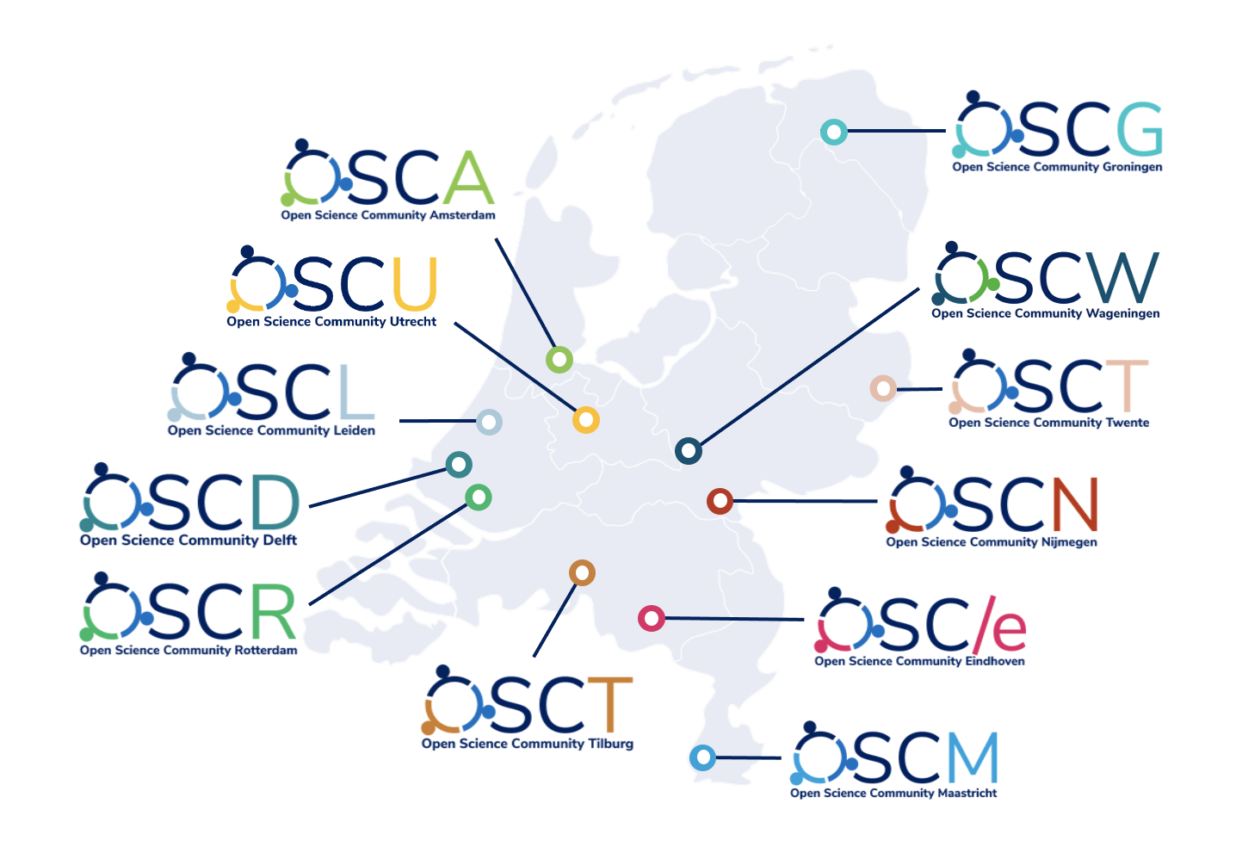
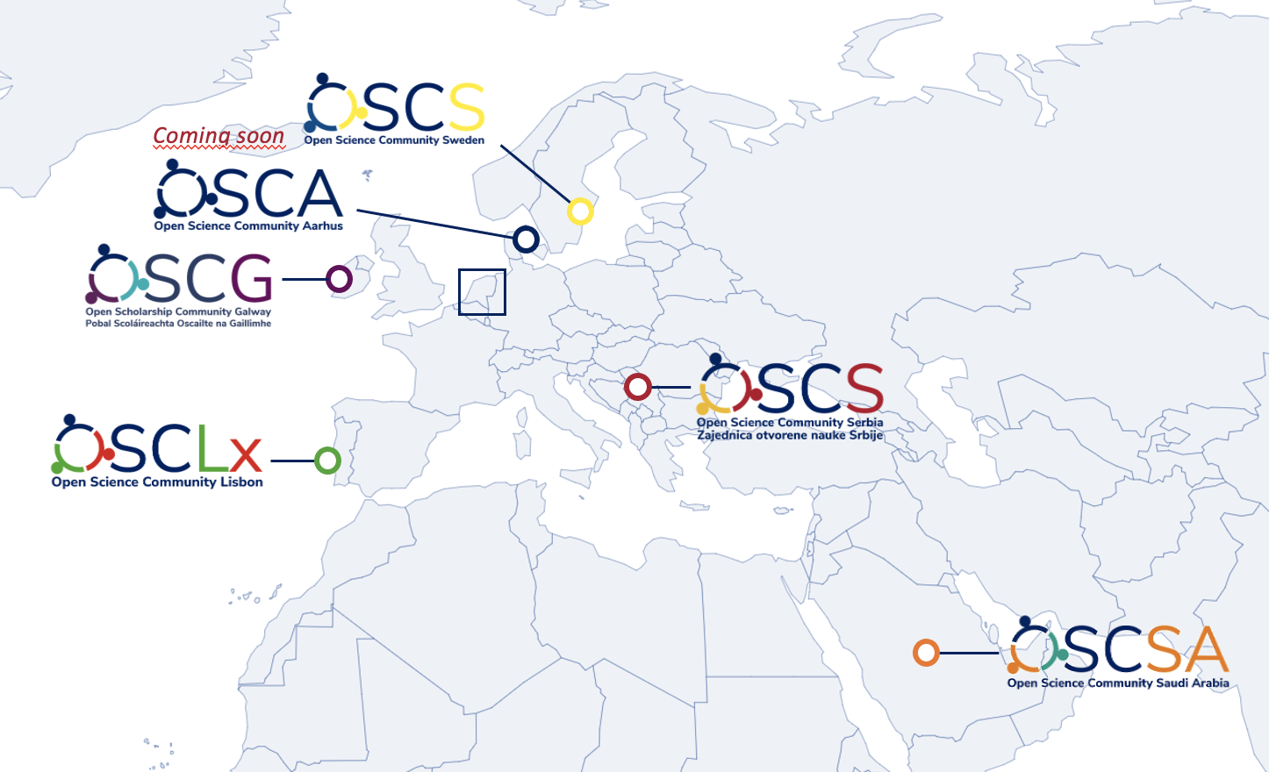


Slide 10




@AnitaEerland
StartYourOSC.com
OSC-international.com
anita.eerland@ru.nl

