Slide 1

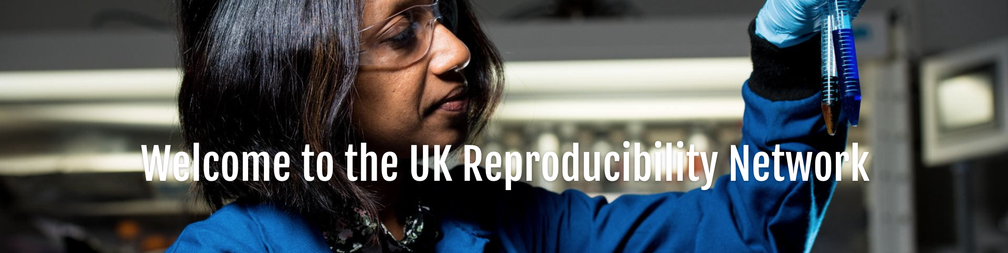
Dr Etienne B. Roesch | NERC Discipline Hopper | Associate Professor of Cognitive Science
Dept. Meteorology CINN, School of Psychology & Clinical Language Sciences
@etienneroesch | osf.io/ede88 | slides: osf.io/evpzf

Slide 2
Conflicts of interest
UKRN (https://ukrn.org) is a grassroot scholarly initiative that undertakes and supports initiatives on issues related to reproducibility in science practices.
It ONLY receives direct public funding from competitive grant schemes, and indirect support from UK higher education institutions.
It DOES NOT receive funding from our group of Stakeholders.
I currently sit on the UKRN steering group. My time is funded by the University of Reading, as Associate Professor, as well as direct public funding from competitive grant schemes. I represent the University of Reading as UKRN Institutional Lead and have been UKRN Local Network Lead. I am also a Workstream Lead on the UKRN national programme, funded by Research England 2021-26.
I volunteer for https://rescience.org and https://rescience.github.io/, as well as Adaptive Behavior (SAGE).

Slide 3
Grassroot community building counteracts systemic pressure by leveraging researchers fire

Slide 4
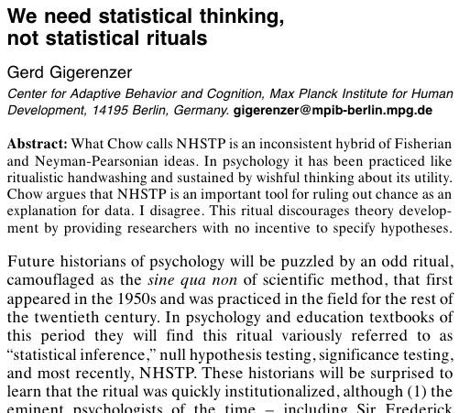
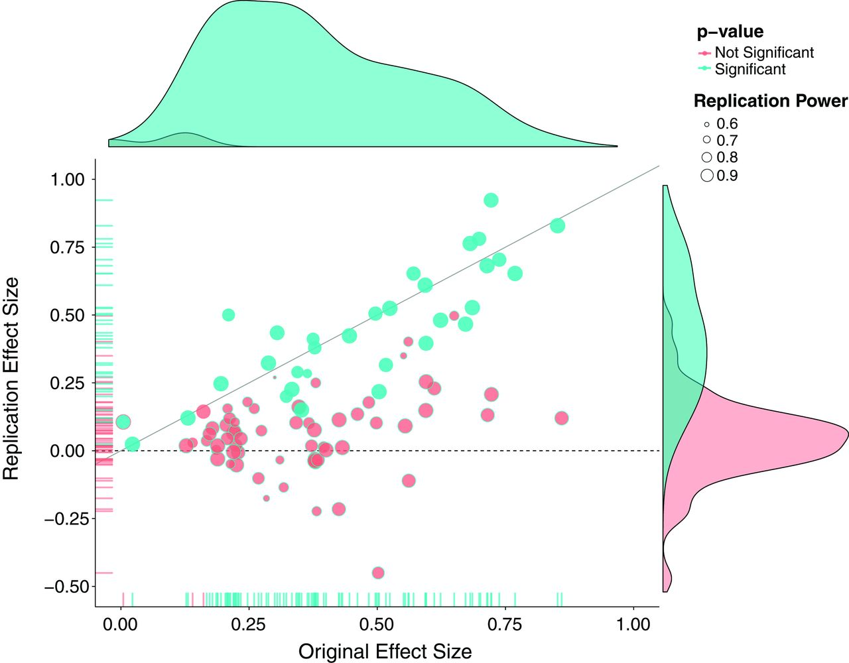
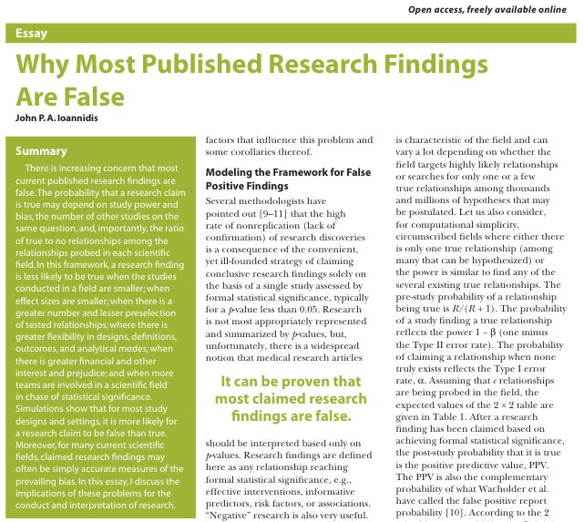
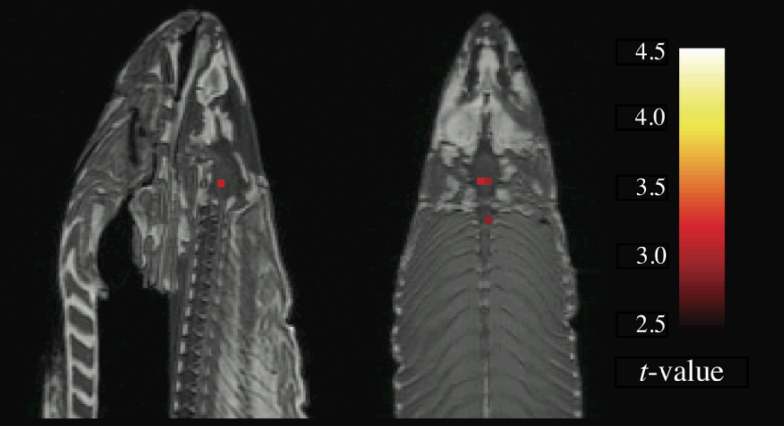
Nosek, et al. (2015). Estimating the reproducibility of psychological science. Science, 349(6251), aac4716.
Ioannidis (2005). Why Most Published Research Findings Are False. PLoS Med. 2.
Gigerenzer (1998) We need statistical thinking, not statistical rituals. BBS. 21, 199–200 (1998).
N = 39
N = 61
😱
Successful replication:
Camerer et al. (2018). Evaluating the replicability of social science experiments in Nature and Science between 2010 and 2015. Nature Human Behaviour, 2(9), 637–644.
Errington et al. (2021). Investigating the replicability of preclinical cancer biology. ELife, 10, e71601.
62%
Bennett et al. (2009). Neural correlates of interspecies perspective taking in the post-mortem Atlantic Salmon: an argument for multiple comparisons correction. NeuroImage, 47, S125.
46%
(if you squint)

Slide 5
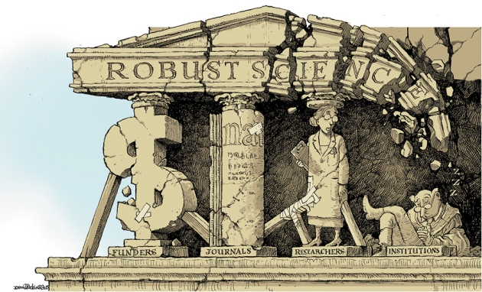
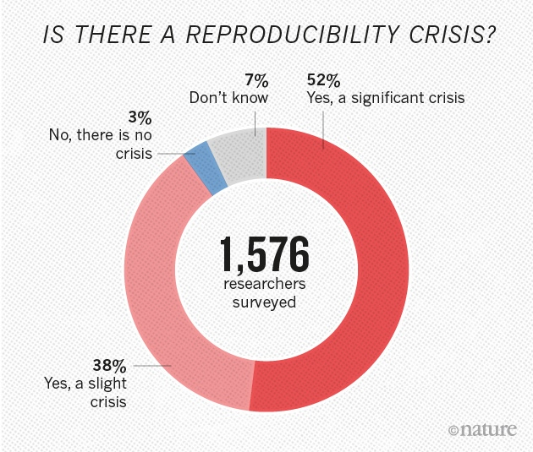
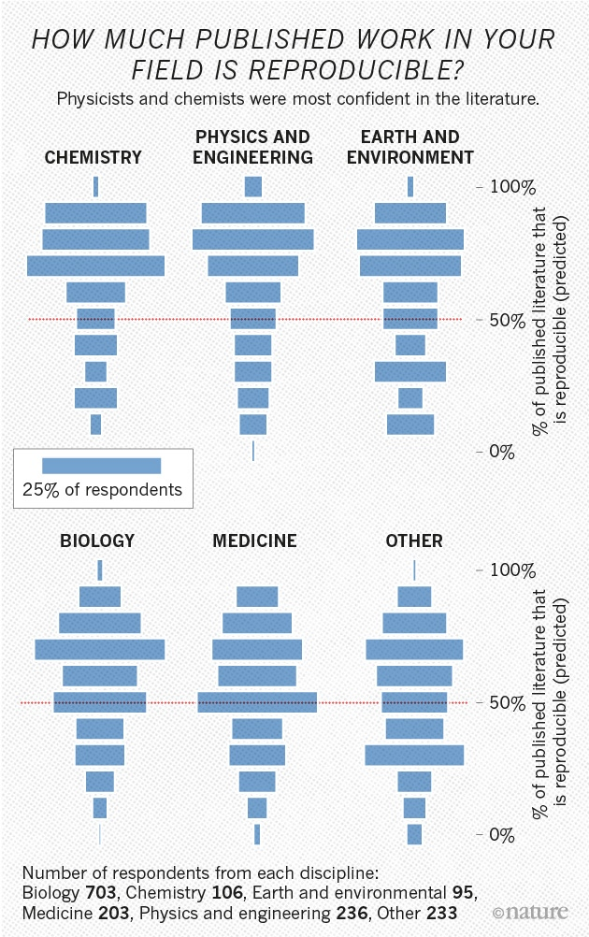
Baker, M. (2016). 1,500 scientists lift the lid on reproducibility.
Nature News, 533(7604), 452. https://doi.org/10.1038/533452a

Slide 6
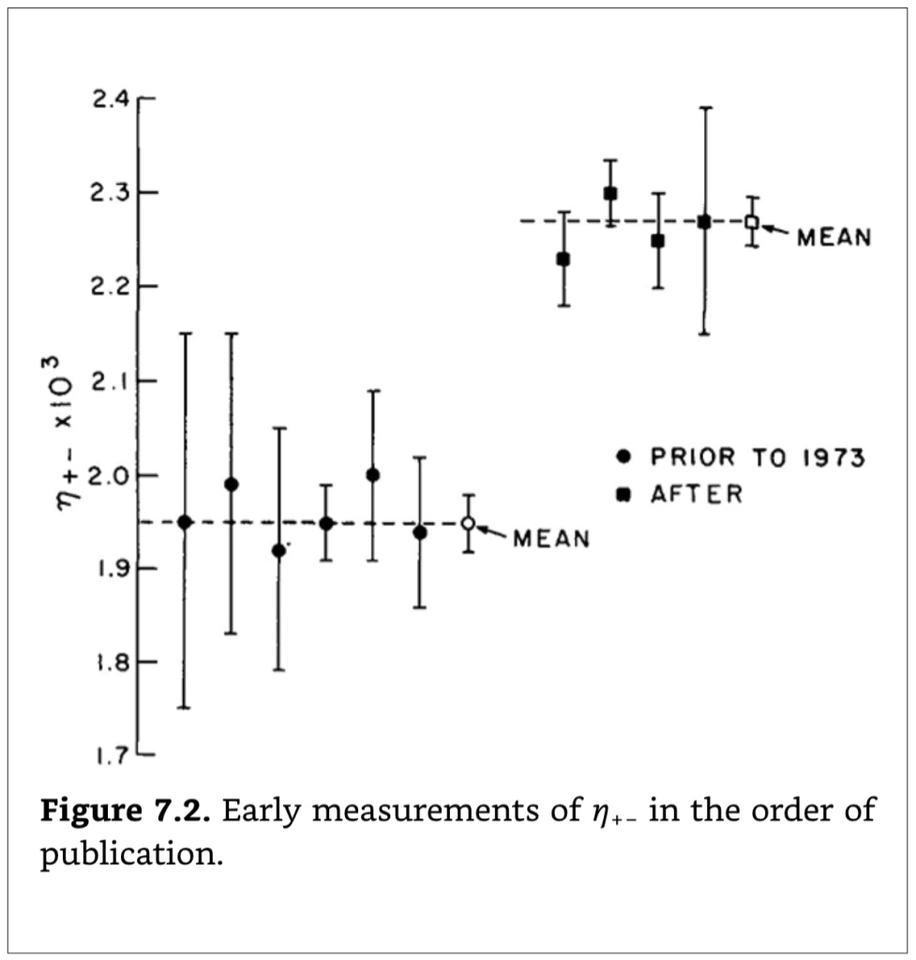
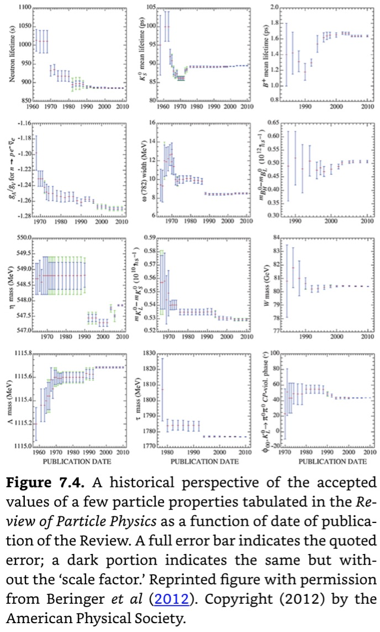
They were not even looking
for η+-
8 standard
deviations (σ) !!
Reproduced by courtesy of Prof. Allan Franklin
“Is it the same result? Replications in Physics”
https://youtu.be/Ohdb6YNgbX0?t=1828
See also, Milton, M. J. T., & Possolo, A. (2020). Nature Physics, 16(2), 117–119. https://doi.org/10/ggktsr

Slide 7
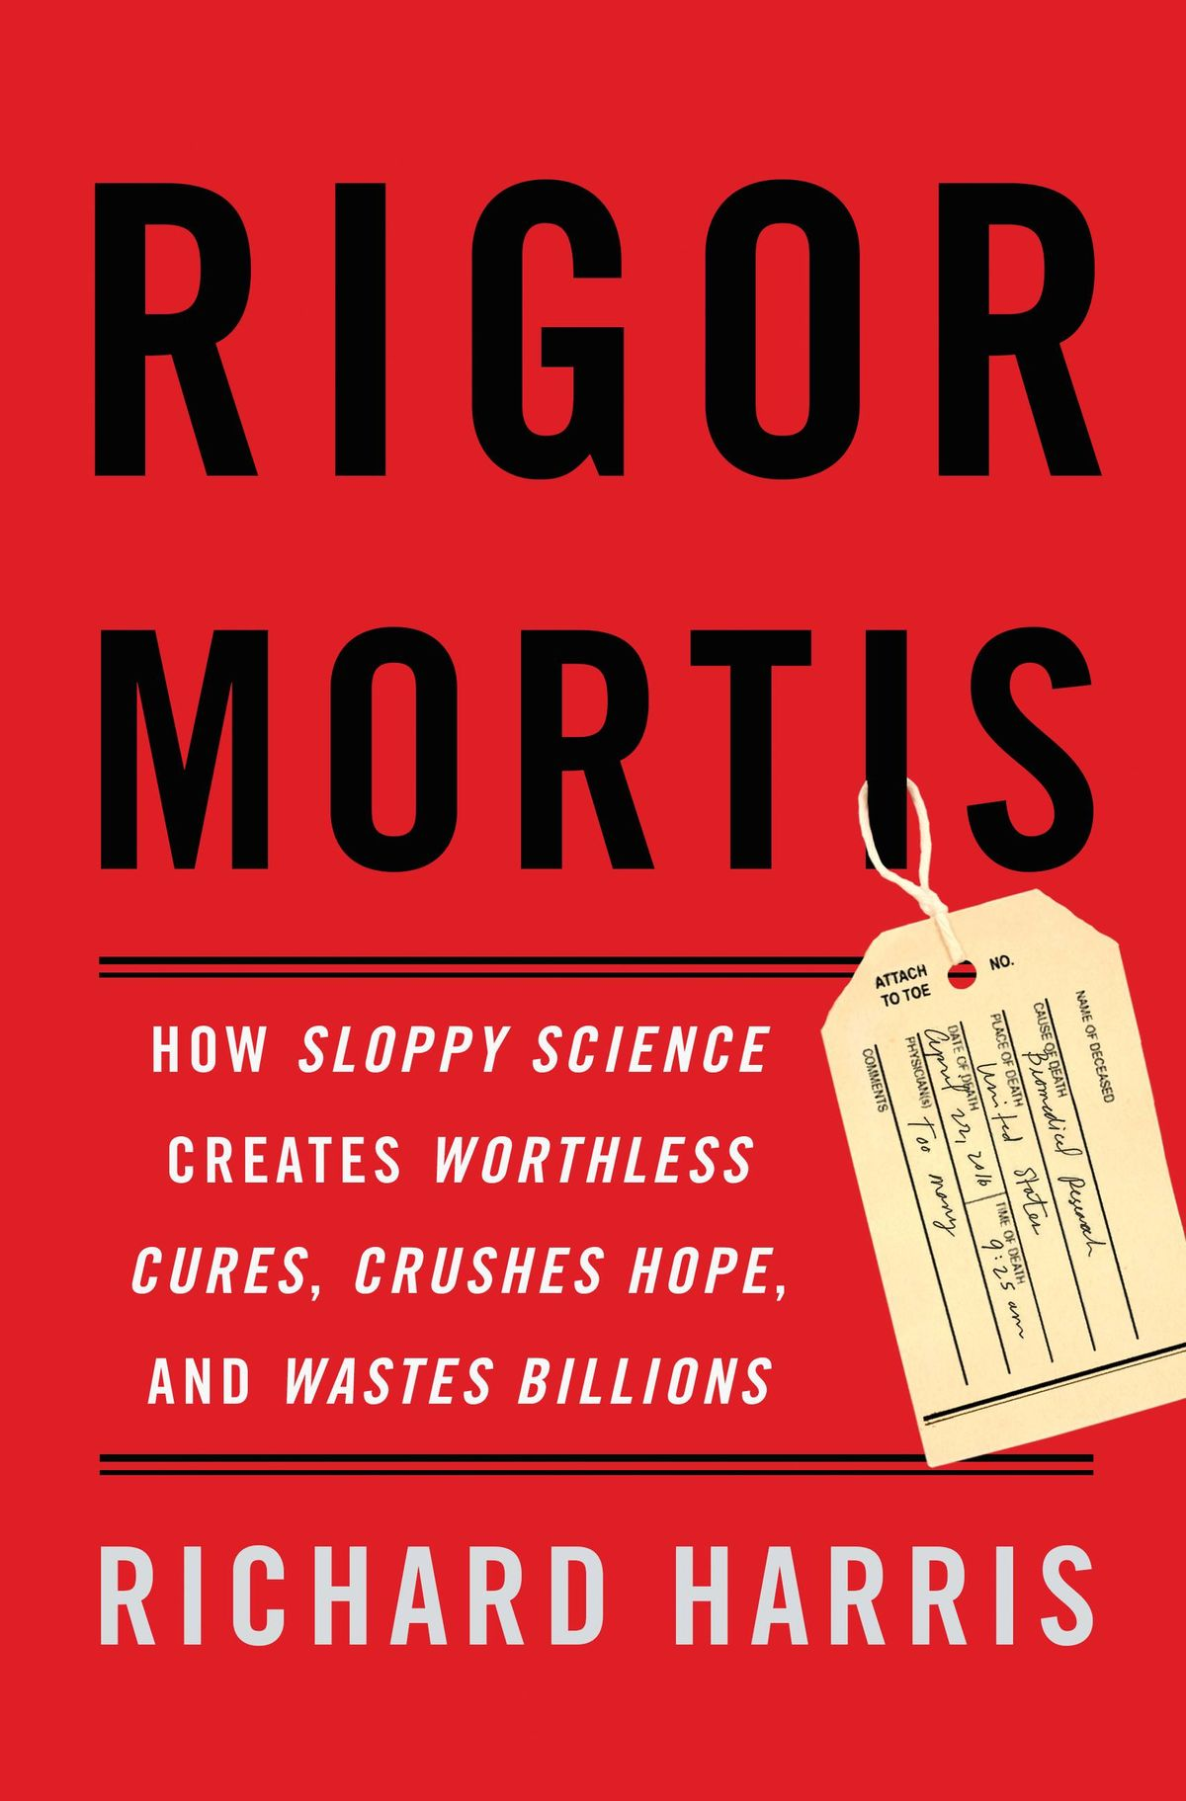


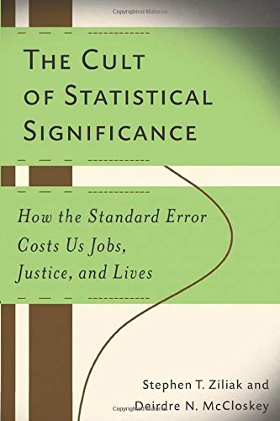

The scale of the problem
Some root causes
Our responsibility as scientists

Slide 8
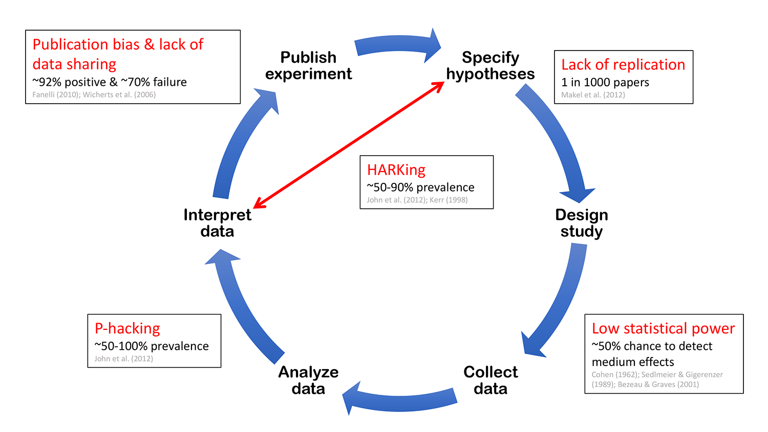
Not so much a “crisis”, as we are doing sloppy work in a sloppy of societal system.
Munafò et al. (2017). A manifesto for reproducible science.
Nature Human Behaviour, 1(1), 0021. https://doi.org/10.1038/s41562-016-0021
Wrong incentives
Wrong success metrics
Wrong focus

Slide 9
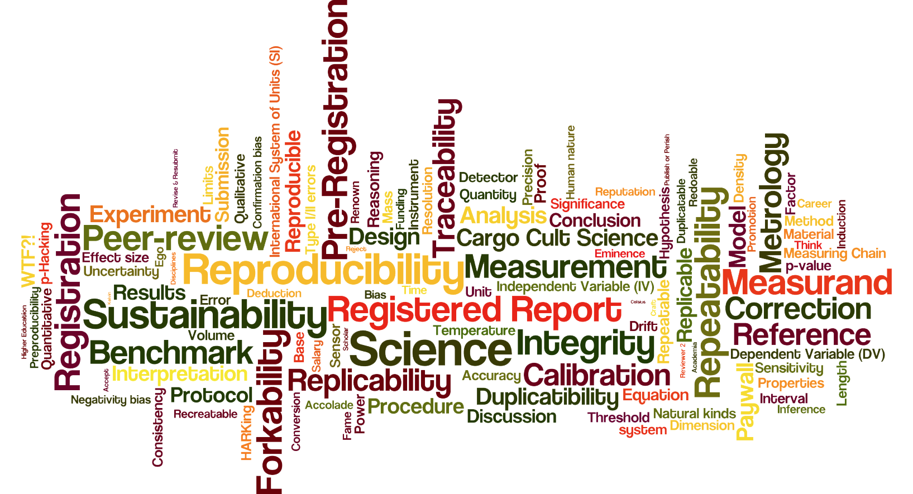

Slide 10
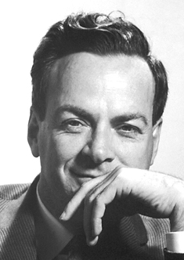
Richard P Feynman (1918-1988)
“But this long history of learning how to not fool ourselves ­­of having utter scientific integrity ­­is, I'm sorry to say, something that we haven't specifically included in any particular course that I know of. We just hope you've caught on by osmosis.
The first principle is that you must not fool yourself ­­and you are the easiest person to fool. So you have to be very careful about that. After you've not fooled yourself, it's easy not to fool other scientists. You just have to be honest in a conventional way after that.”
Surely You're Joking, Mr. Feynman! (1997), p. 198. (my emphases)

Slide 11
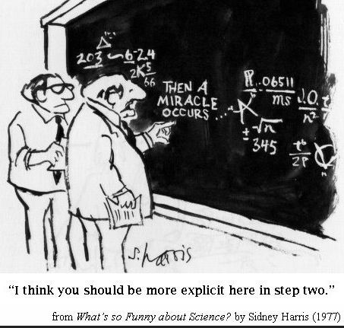
Reproducibility is not more solely focused on being able to run code twice, than open research is solely focused on sharing data.
It is the commitment to doing good research; robust research that can be communicated effectively and trusted
Reproducibility of methods
Replicability of results
.. and everything in between

Slide 13
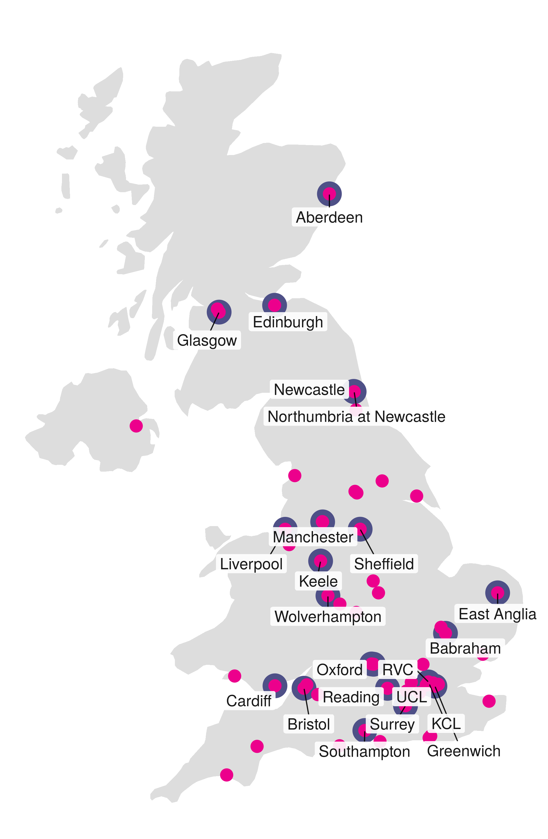
UKRN Steering Group, reports to
25 Institutional Leads (formal appointments by Institutions)
66 Local Network Leads (local contacts and advocates)
9 members on Advisory Board
50 stakeholders organisations (full, and affiliates)
Together, we
Provide training and training material
Support local initiatives, tools and platforms
(alternative publishing, shared calendars, badges)
Engage with national and international stakeholders

Slide 14
Nosek, et al. (2015). Estimating the reproducibility of psychological science. Science, 349(6251), aac4716.
2015 – meeting held by the Academy of Medical Sciences, jointly with the Biotechnology and Biological Sciences Research Council (BBSRC), Medical Research Council (MRC), and Wellcome Trust
2017 – Workshops at University of Reading, University of Oxford, …
2019 – UKRN founding meeting in London
2021 – Evidence to The Science and Technology Committee inquiry into reproducibility and research integrity (House of Lords)
https://parliamentlive.tv/event/index/e4fa2fa3-7f11-4dfa-b077-68795defbe8c
2022 – https://committees.parliament.uk/writtenevidence/107479/pdf/
2021-26 – £8.4M by Research England, to initiate national programme

Slide 15
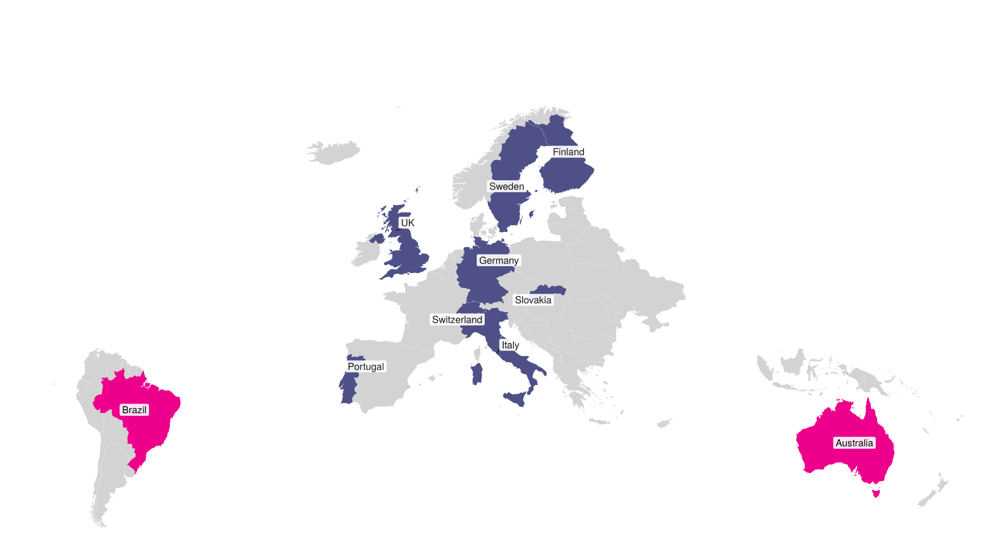
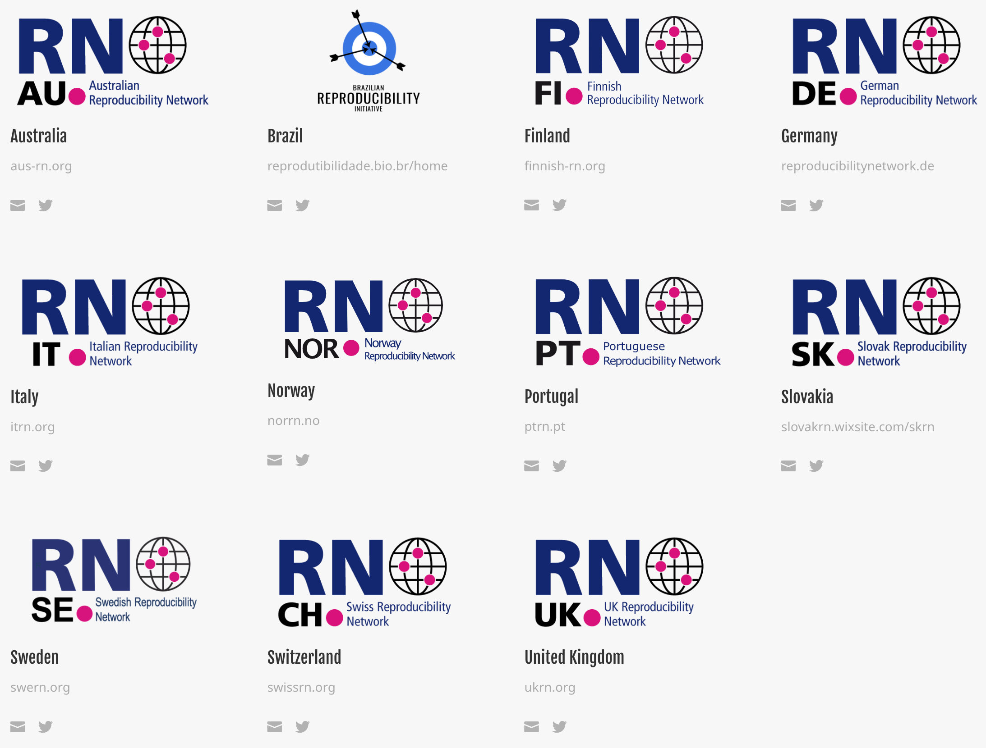

France

Slide 16
Grassroot community building counteracts systemic pressure by leveraging researchers fire

Slide 17
Thank you for your time! https://ukrn.org
UK Reproducibility Network Steering Committee (2021).
From grassroots to global: A blueprint for building a reproducibility network. PLOS Biology 19(11): e3001461. https://doi.org/10.1371/journal.pbio.3001461
Stewart, S.L.K., Pennington, C.R., da Silva, G.R. et al. (2022). Reforms to improve reproducibility and quality must be coordinated across the research ecosystem: the view from the UKRN Local Network Leads. BMC Res Notes 15, 58. https://doi.org/10.1186/s13104-022-05949-w
UK Universities’s Open Research statements: https://www.ukcorr.org/2020/12/02/open-access-is-not-enough-reproducible-science-research-and-scholarship/
Yaqoob, Darby (2021, September 17). Eight ways your university can make research culture more open. THE Campus Learn, Share, Connect. https://www.timeshighereducation.com/campus/eight-ways-your-university-can-make-research-culture-more-open

